Slide 1
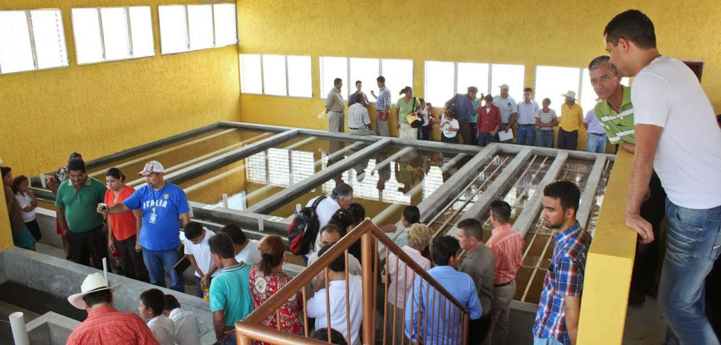
An Elegant Solution for Safe Water on Tap
Monroe Weber-Shirk

Slide 2
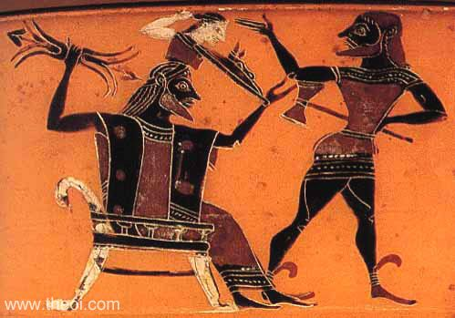


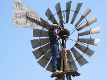

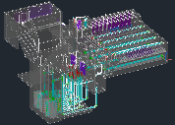
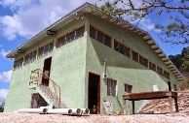
Overview
How to Innovate and Design
The AguaClara Consortium
High-tech and Elegance
Pride of ownership
AguaClara technologies and plants
Philosophy and Reflections
Ctrl + click the pictures to go each section!

Slide 3
Overview
How to Innovate and Design
The AguaClara Consortium
High-tech and Elegance
Pride of ownership
AguaClara technologies and plants
Philosophy and Reflections
Ctrl + click the pictures to go each section!

Slide 4
Three ideas…
Evolution – Iteration – Mistakes - Learning
Creativity for Environmental Engineers can be expressed in how we solve the challenges of the interaction between fluids, particles, and geometry
It’s about details! (It is about all of the things that traditional textbooks tend to ignore.)
Density currents caused by temperature change
Flow distribution to reduce mean currents
Notes:
Microbes are awesome particles!

Slide 5
Inventing Perfection
“Furthermore, as the full scale plant is already in operation, the need for further design changes is not clear.” -(Anonymous Reviewer)
Ideas spring fully formed from their creator’s mind?
Athena leaped from Zeus's head, fully grown and armed
http://designserver.cee.cornell.edu/Designs
Notes:
What about iteration and feedback?

Slide 6
Overview
How to Innovate and Design
The AguaClara Consortium
High-tech and Elegance
Pride of ownership
AguaClara technologies and plants
Philosophy and Reflections
Ctrl + click the pictures to go each section!

Slide 7






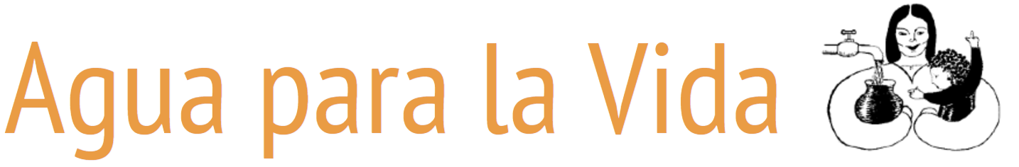



AguaClara Consortium
R&D
Transfer
Operate
Market
Municipalities
Implementers
Water Boards
Implement
Finance
Municipalities

Slide 8











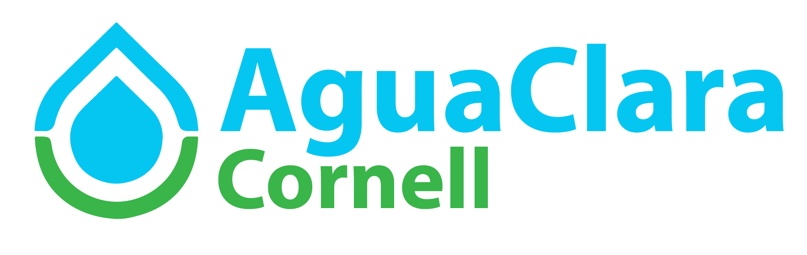
Finance Research/Invent/Design/Engage
Consulting firms
donors
graduates
Cornell connections
Cornell Institute for Public Affairs
Architecture Art Planning
Atkinson Center
Tata-Cornell Institute

Slide 9

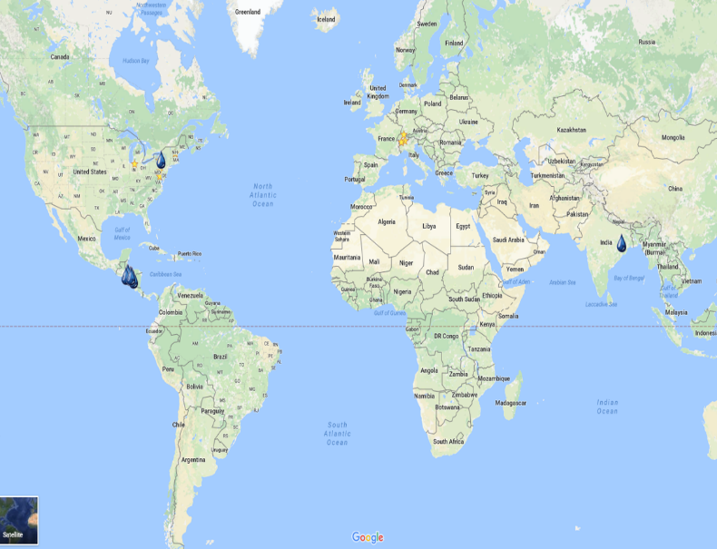
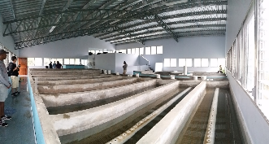

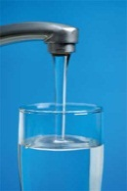
Design tool
Finance Implementation
Municipalities
Water Board
Implementation Partners
AguaClara Engineers

Slide 10
Overview
How to Innovate and Design
The AguaClara Consortium
High-tech and Elegance
Pride of ownership
AguaClara technologies and plants
Philosophy and Reflections
Ctrl + click the pictures to go each section!

Slide 11
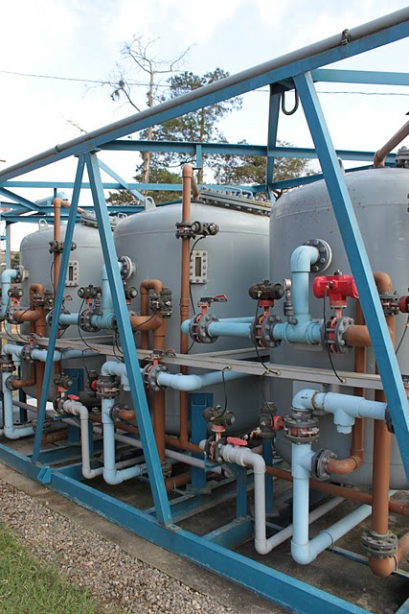
What is the conventional high tech solution?
Technologies from the early 1900’s: flocculation – sedimentation – filtration – disinfection
“Advances” over the last 50 years have focused on automation and increased use of automation
Increased cost, reduced reliability, more difficult to maintain, reduced useful life (cell phone life)
50% of the high tech plants that were installed in Honduras since 2003 have been abandoned

Slide 12
What happens when high tech water meets small town?
Software expires and no one is able or willing to pay for the upgrade
Everything that moves fails!
Valves, pumps, compressors, switches, relays
Electricity bill is too high
Entire treatment plant is abandoned
3 year average life for package plants installed in Africa – World Bank Engineer

Slide 13
Simple, Elegant, or Complicated?
“Any intelligent fool can make things bigger, more complex, and more violent. It takes a touch of genius — and a lot of courage – to move in the opposite direction.” --- E.F. Schumacher
“Simplicity is the ultimate sophistication.” --- Leonardo da Vinci

Slide 14
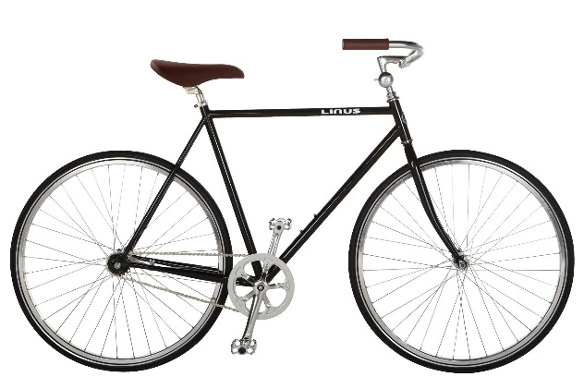

Elegant Solution
Solves the problem very well
No unnecessary complexity
Easy to understand
Simple and beautiful
Bicycle
Windmills
Context matters in defining elegant!

Slide 15
Overview
How to Innovate and Design
The AguaClara Consortium
High-tech and Elegance
Pride of ownership
AguaClara technologies and plants
Philosophy and Reflections
Ctrl + click the pictures to go each section!

Slide 16

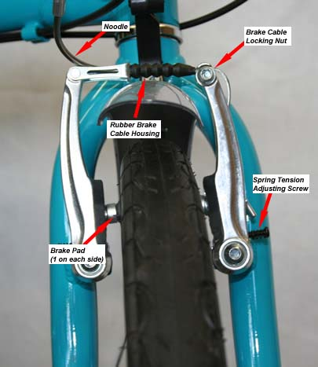

Pride of Ownership
What happens when the check engine light goes on in your car?
What do you do if your bicycle brakes need to be adjusted?
What does the plant operator do if the chemical feed stops working?
We want the plant operator to diagnose and fix the problem without needing to call anyone.

Slide 17
Overview
How to Innovate and Design
The AguaClara Consortium
High-tech and Elegance
Pride of ownership
AguaClara technologies and plants
Philosophy and Reflections
Ctrl + click the pictures to go each section!

Slide 18

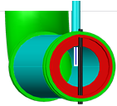


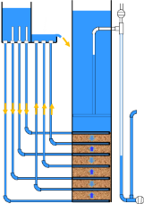
AguaClara Technologies
Chemical dosing
Rapid Mix
Flocculator
Sedimentation
Filtration
Conclusions

Slide 19



Stages of particle removal
Coagulation
Flocculation
Floc Blanket
Sedimentation
Filtration
Nanoglob deposition
Collisions
More Collisions
Gravity!
Last chance!
Notes:
Here are the five stages of colloid or particle removal in hydraulic drinking water treatment plants. The first stage, coagulation, involves the addition of a chemical coagulant to destabilize a suspension of particles. The coagulant precipitates and attaches to the particle surface. Then in flocculation, velocity gradients in the water cause the particles (now coated in precipitated coagulant) to collide and stick to one another forming aggregates. In floc blankets there are many more opportunities for collisions. In sedimentation, fluid flow is very slow and the aggregates settle to the bottom of the tank. Filtration is often used to remove any remaining particles but is not included in the bench-scale setup.

Slide 20
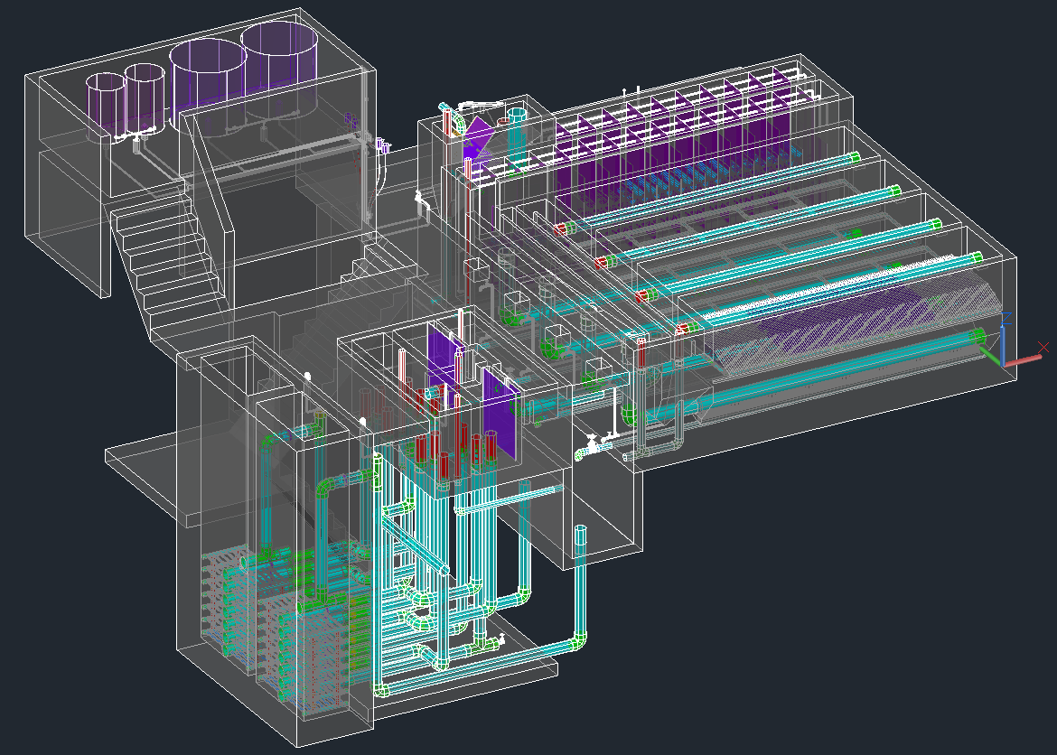
Chemical Dosing
Entrance Tank
Chemical Stock Tanks
Flocculator
Sedimentation
Open Stacked Rapid Sand (OStaRS) Filter
Drain Channel

Slide 21
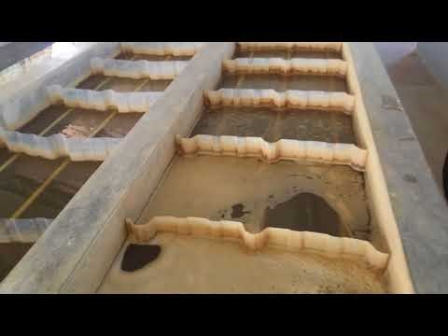
Tour of an AguaClara plant

Slide 22
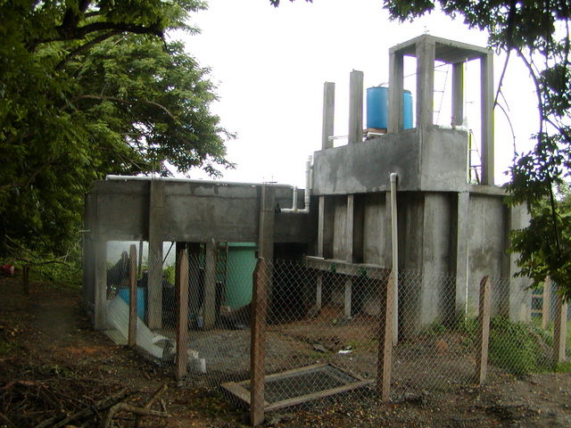
Entrance Tank
Elevated flocculator
Sedimentation Tank

Slide 23
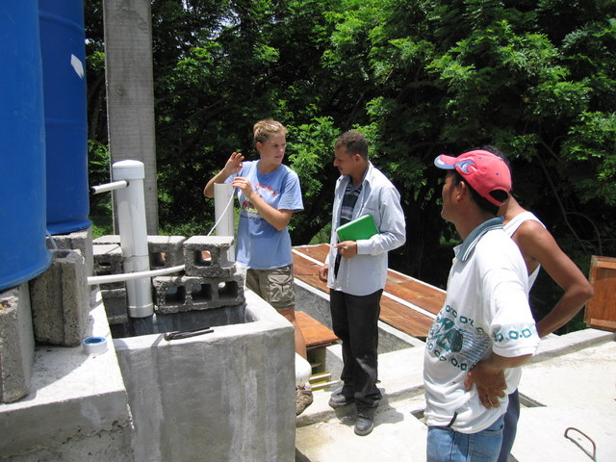

Slide 24
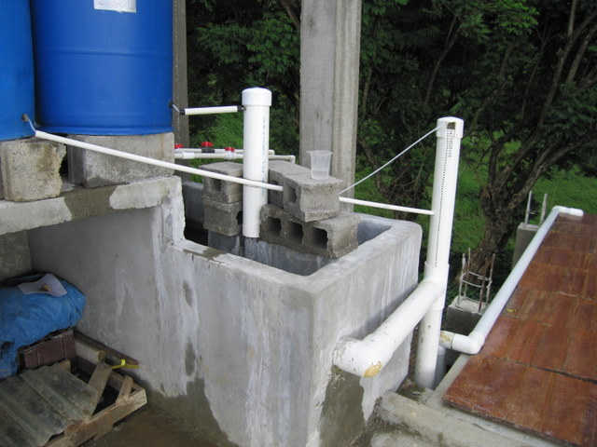
What do you see?
Why did this happen?

Slide 25
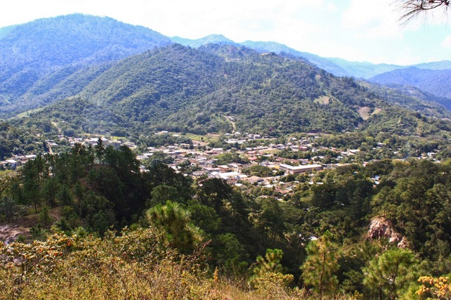

Slide 26
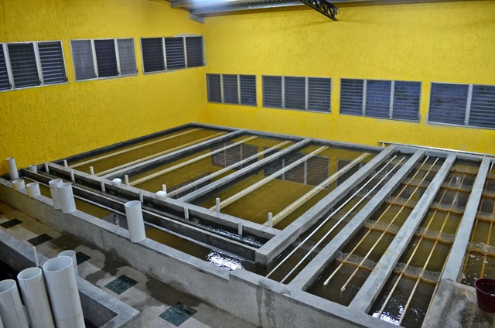

Slide 27
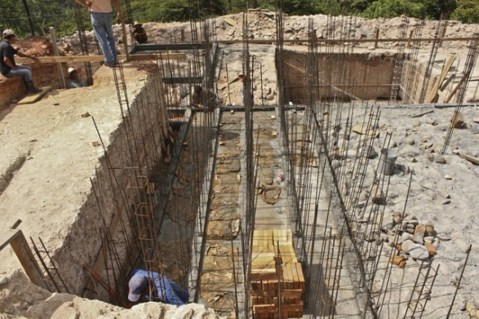
Flocculator Channels

Slide 28
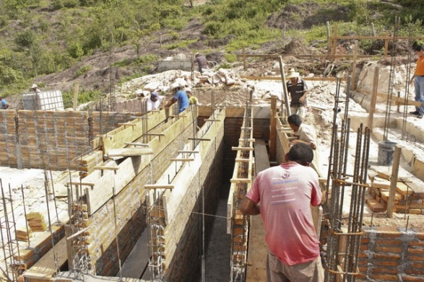

Slide 29
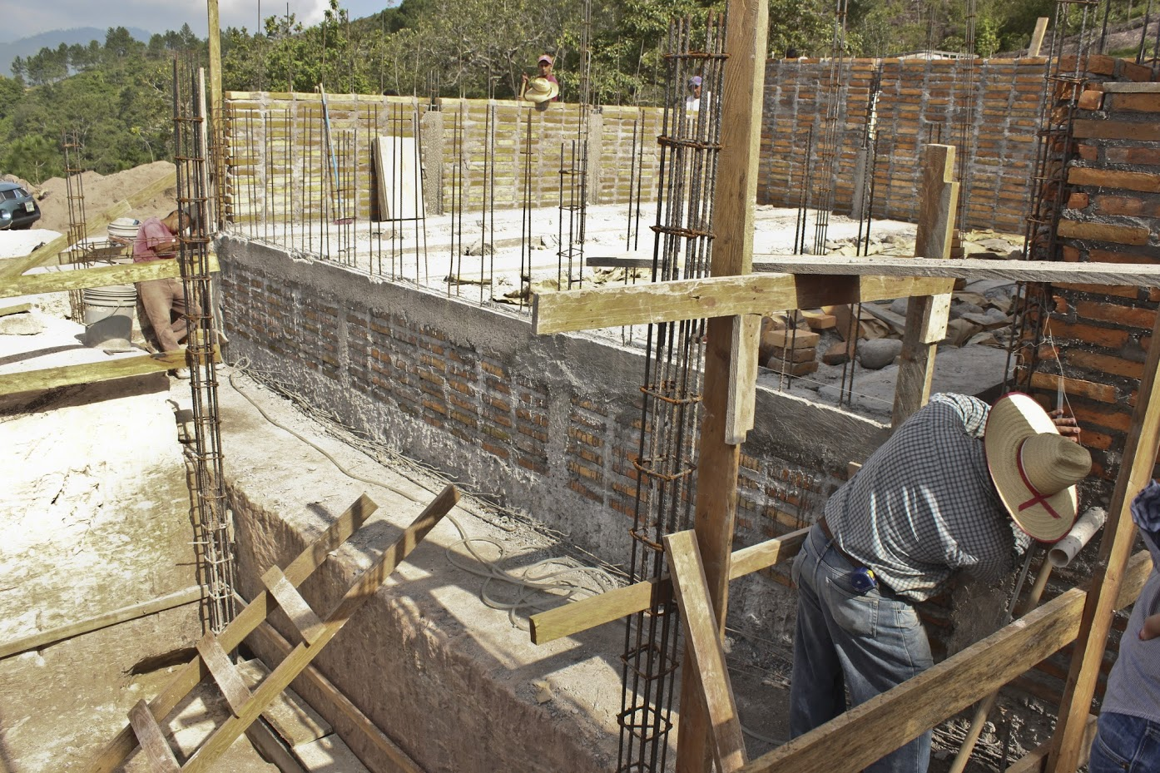
What do you see?

Slide 30
What is the difference between laser level and water level?
Suppose I am building a really big structure…

Slide 31
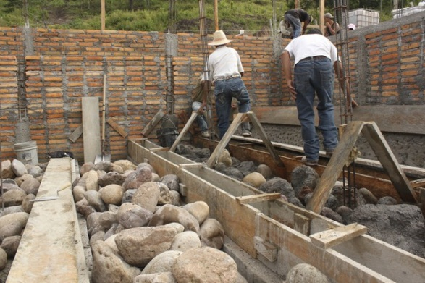

Slide 32
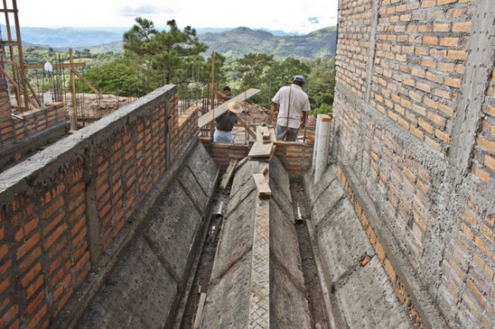

Slide 33
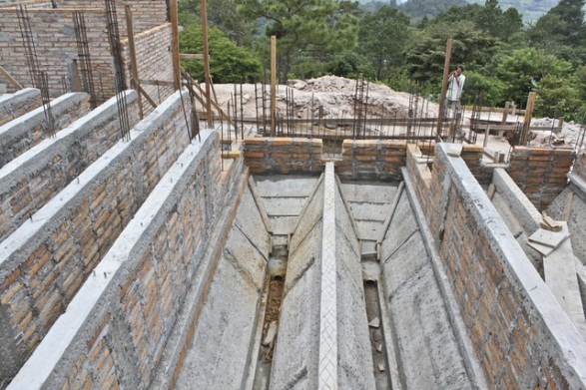

Slide 34
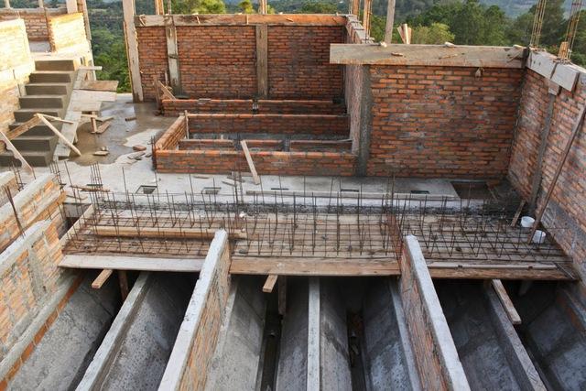

Slide 35
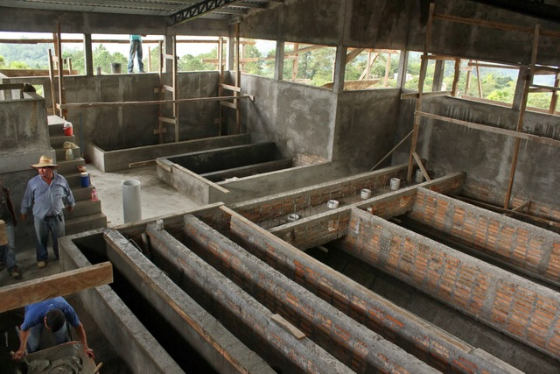
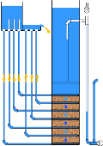


Slide 36
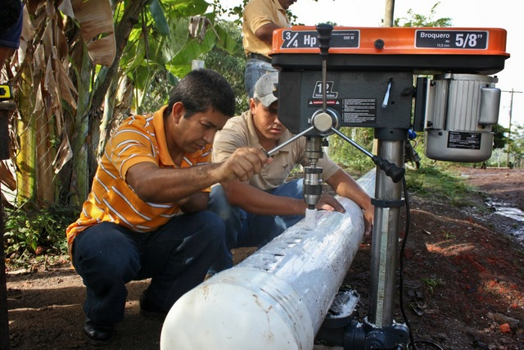

Slide 37
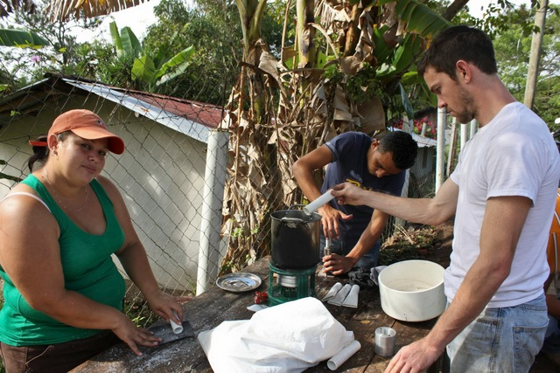

Slide 38
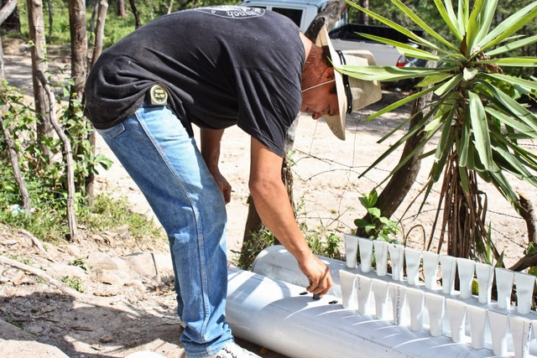

Slide 39
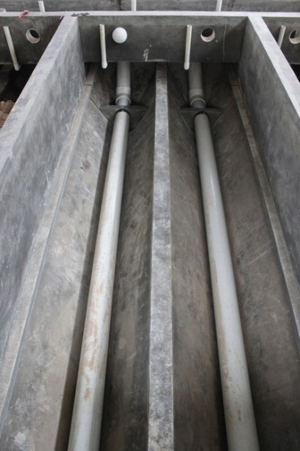

Slide 40
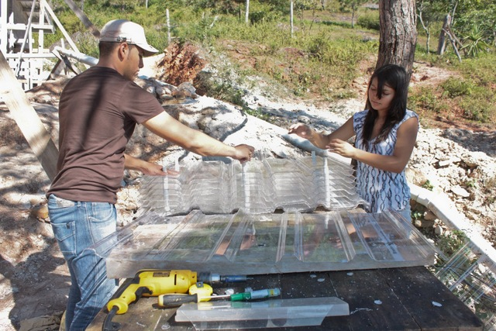

Slide 41
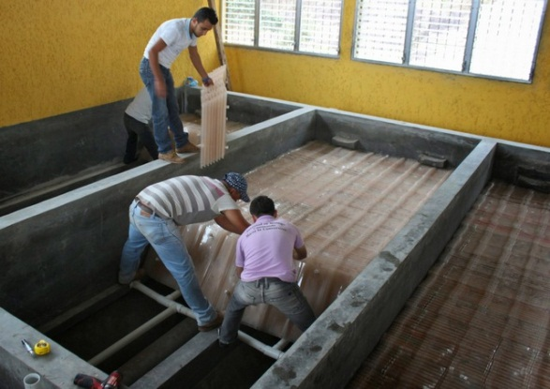
Double bay sedimentation tank design. No longer recommended!

Slide 42
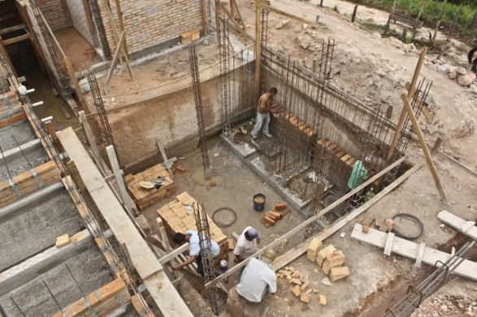

Slide 43
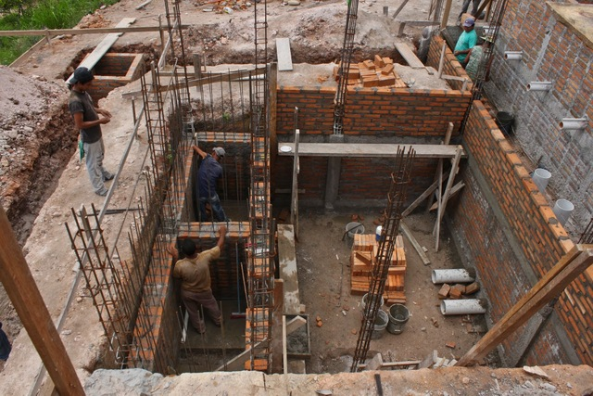
Sed tank drains!

Slide 44
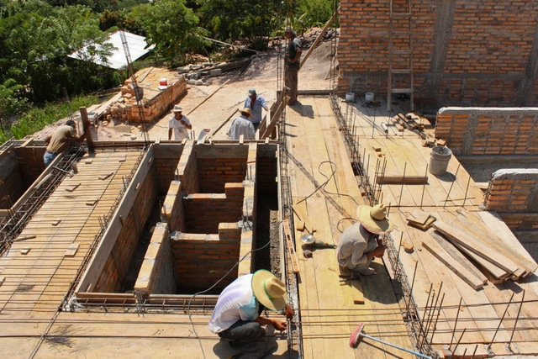

Slide 45
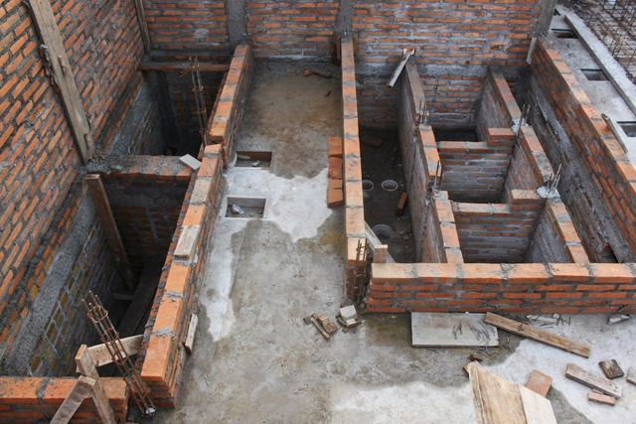

Slide 46
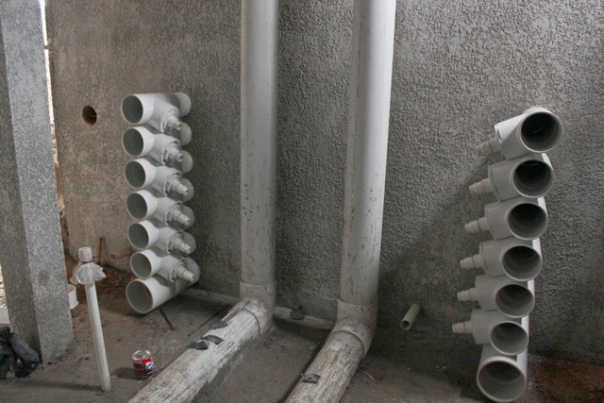

Slide 47


Slide 48


Slide 49


Slide 50


Slide 52
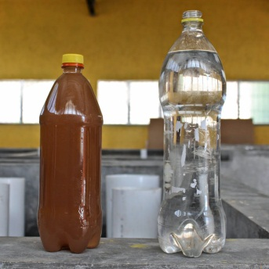
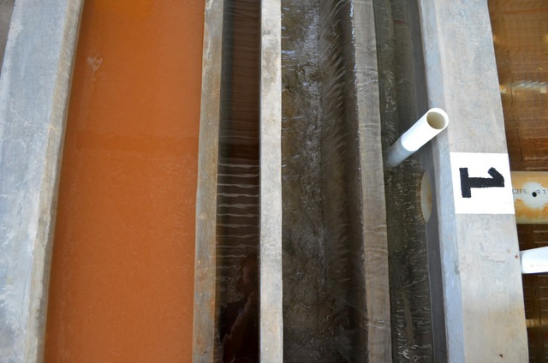
Flocculated water
entering the sedimentation tank
Settled water

Slide 53
Overview
How to Innovate and Design
The AguaClara Consortium
High-tech and Elegance
Pride of ownership
AguaClara technologies and plants
Philosophy and Reflections
Ctrl + click the pictures to go each section!

Slide 54
Three Key Innovations
AguaClara is open source engineering:
Many inventions, ZERO patents
Our technologies are described on our website and published in the literature.
Our example designs are available on the web!
Our technologies use ZERO electricity (except for batteries in the turbidimeters)
Some plant performance data is online

Slide 55

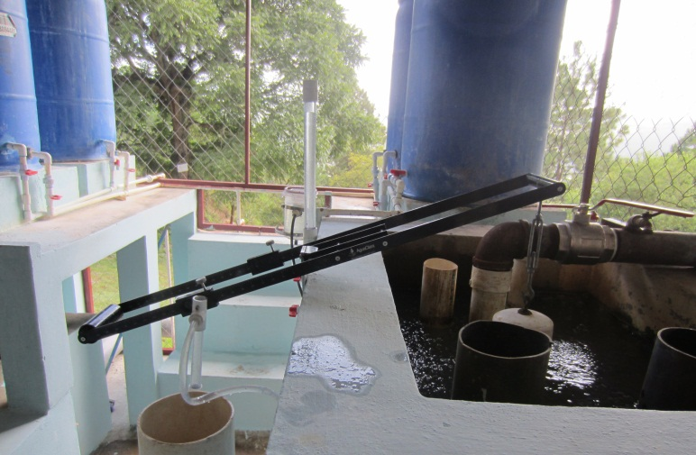
How Much Does it Cost?
CAPITAL COST
$100,000 + $8000 per L/s of capacity*
OPERATING COST
$5 per person per year
or $50 per million liters
ELECTRICITY COST
ZERO
Notes:
Quick and rough cost estimates.

Slide 56


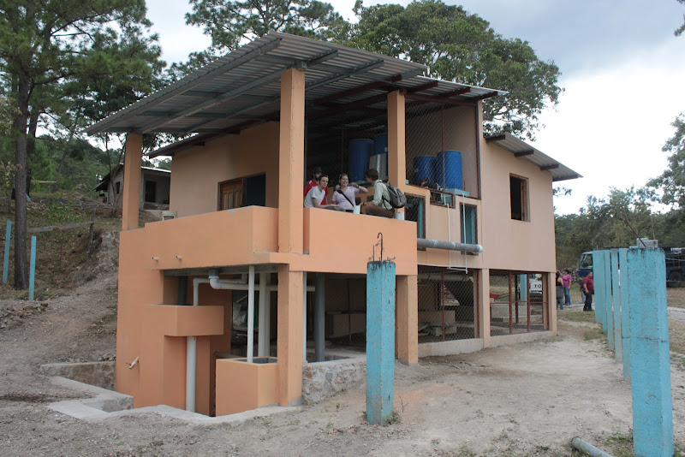
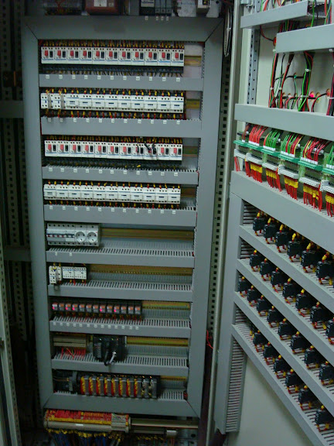
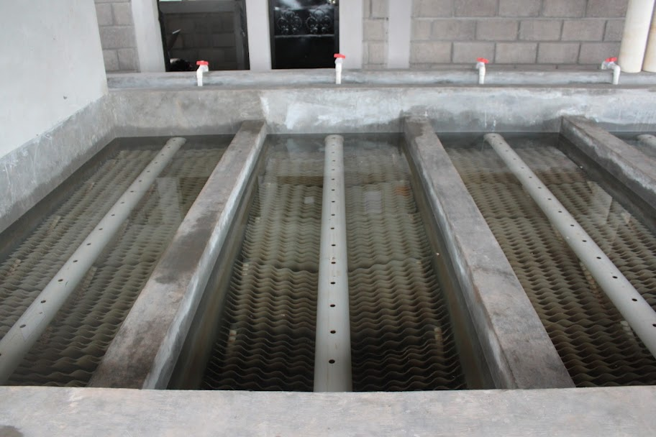
Reflections
Technology and Engineering Philosophy matter!
Infrastructure failures often have multiple causes and many of them are linked to design choices
We design for Simplicity on the other side of Complexity

